Slide 1
Chapter 12: Stoichiometry
Chemistry - 2019

Slide 2
Problem Set:
Pg. 357 – 373
#’s 4, 6, 7, 10, 15, 17, 22

Slide 3
Topics
12.1 Intro
12.2 Stoichiometry calculations
Mole to mole
Mole to mass
Mass to mass
12.3 Limiting Reactants and Excess
12.4 Percent Yield

Slide 4
Chapter 12 Prior Knowledge
Mole conversions
Balancing
Writing formulas of compounds and molecules
Some basic mathematics
A desire to learn and expand your knowledge
This chapter truly asks you to put it all together!

Slide 5
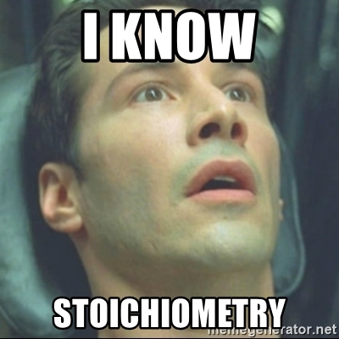
After this chapter this will be you!

Slide 6
12.1 Stoichiometry Intro
What is stoichiometry?
Stoichiometry - Defines the quantitative relationships between amount of reactants used and products formed
Operates based on Law of Conservation of Mass
Really its an incredible application of what humans know about matter in the 21st century
We are able to predict with extremely high accuracy how much will be produced from certain reactions

Slide 7
12.1 Stoichiometry
Why is stoichiometry important?
Stoichiometry describes how much of each reactant is required to make a product
Stoichiometry tells us if chemical processes are efficient
Calculations help scientists and engineers working in industry to estimate the amount of products they will obtain from a given procedure
It can also help decide whether the product is profitable to produce or not (low yield vs. high yield)

Slide 8
12.1 Stoich Intro: My favorite stoich analogy

Slide 9
12.1 Stoichiometry: Baking
Stoichiometry is the exact same thing, just at the molecular level!

Slide 10
12.1 Applications to Cooking
Stoichiometry in the kitchen tells us how to scale recipes
Baking especially is extremely reliant on ratios…too much of one thing and the recipe is ruined
If you are baking pies for 75 people, and the recipe (feeds 5) calls for 2 grams of baking soda
How many grams of baking soda do you need?

Slide 11
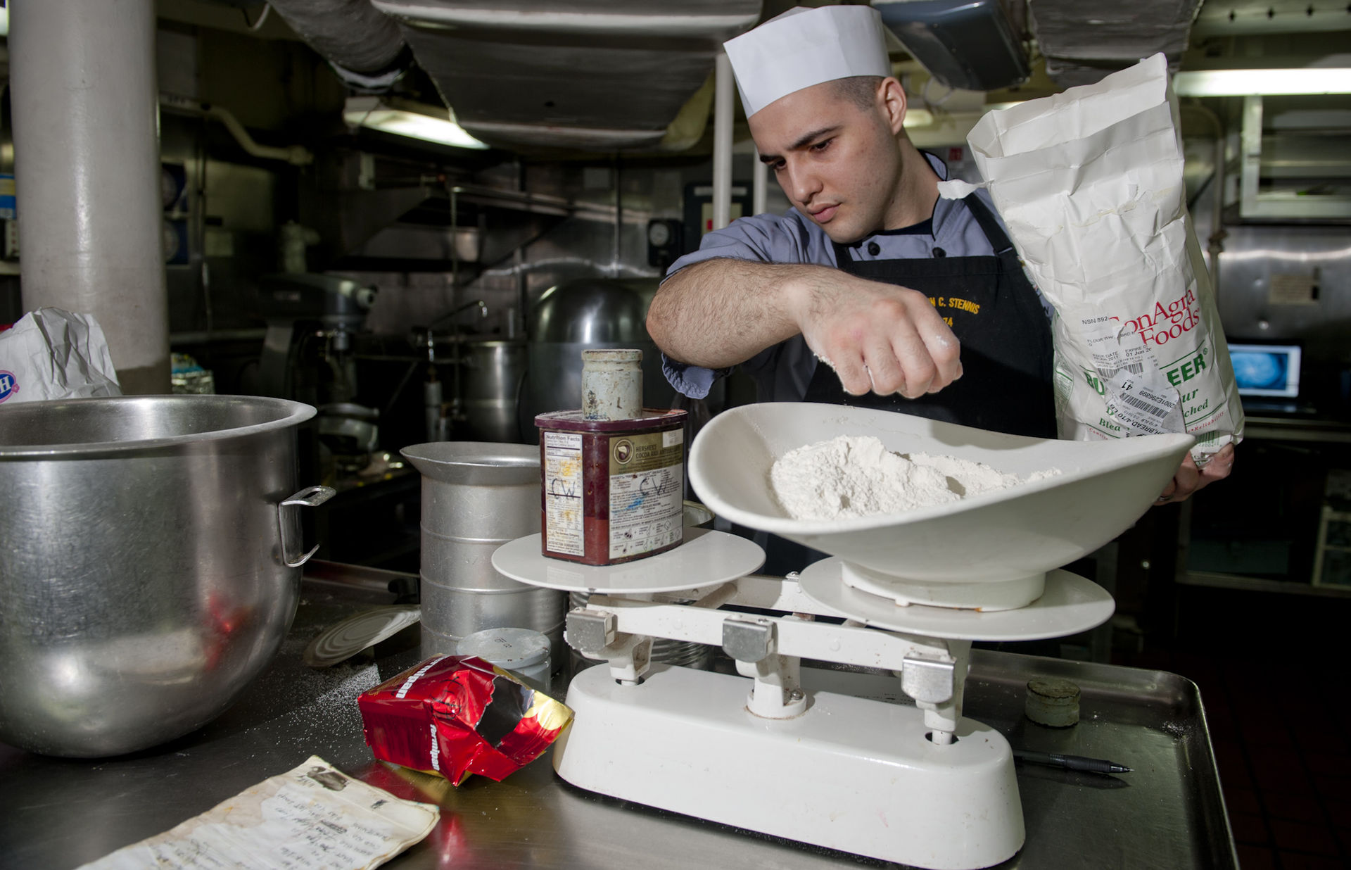
12.1 Baker’s Calculation

Slide 12
12.1 Stoich Intro: My favorite stoich analogy
From the bike analogy…
How many bikes can I make with 142 tires, assuming I have enough frames?
How many bikes can I make with 50 frames?
If I have 42 tires and 13 frames how many bikes can I make?
Will anything be left over? If so what, and how many?

Slide 13
12.1 Stoich intro: How do I start?
Any stoichiometry problem starts with balancing.
So let’s refresh ourselves on how to balance….

Slide 14
12.1 Intro to Stoich:
Example 1:
__ Fe (s) + __ O2 (g) —> __ Fe2O3 (s)
1.) Balance
2.) Determine the number of grams on each side of the equations
3.) Does it make sense?

Slide 15
12.1 Intro to stoich:
Example 2:
__ C3H8 (g) + __ O2 (g) —> __ CO2 (g) + __ H20 (g)
1.) Balance
2.) Determine the number of moles on each side
3.) Determine the mass on each side
4.) Does it abide by the law of conservation of mass?

Slide 16
12.1 Intro to Stoich: Mole ratios
Mole ratios: ratio of the numbers of moles of any two substances in a balanced equation
indicate in what ratio, reactants and products react with each other
Let’s use the bike example to write molar ratios:
Molar ratio: tires to bikes
Molar ratio: frames to tires
Molar ratio: frames to tires

Slide 17
12.1 Stoichiometry Intro: Mole ratios
From this example:
__ Al (s) + __ Br2 (g) —> __ AlBr3 (s)
Molar ratio: Al to Br2
Molar ratio: Br2 to AlBr3
Molar ratio: Al to AlBr3

Slide 18
12.1 Intro to Stoichiometry
Practice these on your own:
Balance and write all 6 ratios for…
__ Al (s) + __ O2 (g) → __ Al2O3 (s)

Slide 19
12.1 Warm Up!
__HgO (s) → __ Hg (l) + __ O2 (g)
Balance and write all 6 ratios!

Slide 20
12.2 Stoichiometric calculations
As stated before, stoichiometry represents the quantitative relationships between amount of reactants used and amount of products formed
Remember that all stoichiometric calculations must begin with….
Balancing!
An incorrectly balanced equation is going to give you incorrect predictions of products

Slide 21
12.2 Stoichiometric calculations
Let’s take a look at our pancake analogy
Using dimensional analysis…
How many pancakes can I make with 12 cups of fluor assuming I have XS of other ingredients
How many eggs do I need to make 48 pancakes?

Slide 22
12.2 Stoichiometric Calculations
Let‘s examine the vigorous reaction of pure potassium and water
Let’s start by predicting the outcome of the reaction
K (s) + H20 (aq) → KOH (aq) + H2 (g)
Is this balanced?

Slide 23
12.2 Stoichiometric Calculations
K (s) + H20 (aq) → KOH (aq) + H2 (g)
Mole to mole conversions: calculation to determine the number of moles produced from reactants OR…
Number of moles of reactant need to produce products
1.) How many moles of H2 are produced from 3 moles of water? (assuming XS)
2.) How many moles of KOH are produced from 0.54 moles of potassium? (assuming XS)
3.) How many moles of K are needed to produce 6.54 moles of hydrogen gas?

Slide 24
12.2 Stoichiometric Calculations
From question 2, how many grams of KOH were produced?
From question 3, how many grams of potassium were needed?

Slide 25
12.2 Stoichiometric Calculations
Independent practice:
__CH4 (g) + __ S8 (s) → __CS2 (l) + H2S (g)
1.) Balance
2.) Calculate the mol of CS2 produced when 1.50 mol of S8 is reacted in XS CH4.
3.) How many mol of H2S are produced?
4.) How many grams of H2S are produced?

Slide 26
12.2 Stoichiometric Calculations: Mole mass
These problems are very similar, there is just one added step
Typically in a laboratory procedure, you are weighing grams not, moles
1.) Balance
2.) Select the proper mole ratio
3.) Convert to moles
4.) Convert final answer to grams

Slide 27
12.2 Stoichiometric Calculations
Example:
__Na (s) + __ Cl2 (g) → __ NaCl (s)
1.) How many grams of NaCl are produced from 1.25 mol of Cl2?
2.) How many grams of sodium are needed to ensure the reaction above happens to completion?

Slide 28
12.2 Stoichiometric Calculations: Mole mass
Independent practice:
__ TiO2 (s) + __ C (s) + __ 2 Cl2 (g) → __ TiCl4 (s) + __ CO2 (g)
1.) If you start with 1.25 mol of TiO2, what mass of Cl2 is required?
2.) How much carbon dioxide is produced in grams?
3.) What mass of TiCl4 is produce?

